Slide 1
Architecting Virtual Machine Solutions
Notes:
Session Abstract: Virtual machines in Azure are very easy to get started with. Simply provide an image for a new virtual machine instance or choose one from the gallery and you’ll be up and running in no time. Just like with on-premises solutions, there are best practices to follow when designing solutions comprised of virtual machines. We will discuss best practices for specific workloads such as identity and database workloads and will highlight the areas that Architects need to remember when designing complex solutions in the cloud.

Slide 2
Agenda
Azure components
Best practices for AD in IaaS
Best practices for SQL database solutions
Migrating workloads
Designing complex solutions in the cloud
Notes:
In this session, we are assuming that you understand the fundamentals of Azure virtual machines. We will dive into 2 of the most common workloads, Active directory and SQL server. We will understand these scenarios a bit more and point out the different issues you may encounter when deploying these workloads.
We feel that understanding how to plan and deploy these workloads on Azure, you will have a good foundation on the different options available when designing your IAAS solutions.

Slide 3
Some Common Misconceptions
“Oh, it’s just VMs in the cloud”
“Just like private cloud on prem”
“Microsoft hosts a bunch of Hyper-V servers in their datacenter”
Notes:
We want to clear up some common misconceptions heard when comparing IAAS on Azure to On premises workloads, co-hosters or managed service providers.

Slide 4
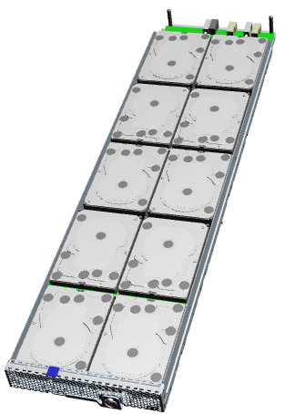
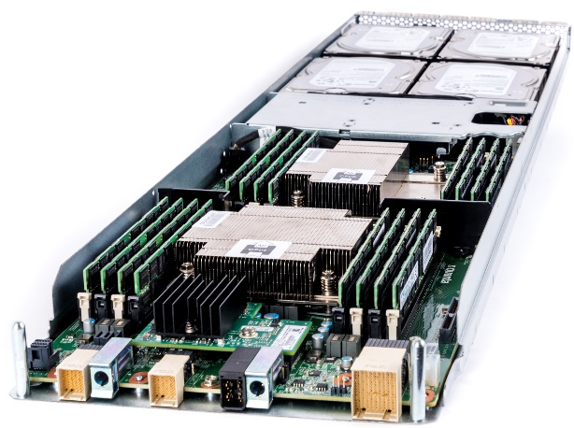
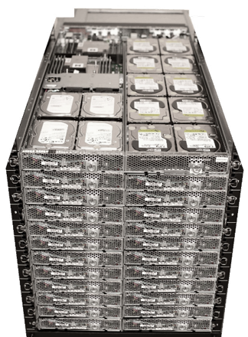
Open CloudServer V2 system
Compute blade
Dual socket Intel E5-2400 v2 Family
4 x LFF HDD, 2 x SFF SSD
2x10G networking
Dual 4X SAS 6G
Storage 6G JBOD
10 x LFF SATA HDD
Dual 4X SAS 6G
6G SAS expander
Notes:
The servers that run Azure are custom. Designed for hyperscale. They are mostly cableless designs to reduce accidental cable disconnects. Power is distributed through the back plane so a tray of blades can be slid into the 1U rack, and be available quickly.
((The FLAs on this page))
LFF == Large Form Factor == 3.5" hard drive
SFF == Small Form Factor == 2.5" hard drive
Cloud services are written very differently than other applications. The applications are written with the understanding that the hardware has just enough reliability, but no more. Software is used to drive up the reliability of the total service and drive down the cost of hardware.
For large scale efficiency, the entire stack from silicon, to the Datacenter are fully integrated and optimized. Microsoft has contributed it’s specifications to enable standardization of these optimizations throughout the industry. The v2 chassis supports both compute and storage blades.
<<click>>
The high performance compute blade with the latest Intel processors supports the storage JBOD blades through dual 4X SAS expansion. The blade has been upgraded from v1’s 6G to 12G SAS connections.
<<click>>
It is compatible with the v1 Storage JBOD. Each compute blade can support up to 480TB storage via 80 HDDs in 8 JBOD blades. They are managed using custom software to reduce the depenecy on different vendor stacks. You can imagine how data is shred across different blades, disks, racks, etc.
<<click>>
The blades can be any combination of compute or storage to meet flexible requirements. Management of the blades and chassis is through the Chassis Manager, an x86 PC. The Chassis Manager is responsible for setting fan speeds, monitoring the health of power supplies and fans, and for the minimum set of out of band features required for running the servers. This includes on, off, fan speed settings, and gathering event logs.
There are six shared power supplies that allow for balanced three-phase power at the datacenter that allows the datacenter to be fully utilized. Six large fans are used to reduce power consumption and enable fault redundancy. The assembly is designed for low-cost manufacturing and pre-rack assembly before arriving at the datacenter.
<<click>>
Here is what a full rack of servers look like. Utilizing a standard 19” EIA rack was very important to creating a flexible platform. To increase overall efficiency, the management, cooling and power is pooled and shared across 24 blades.

Slide 5
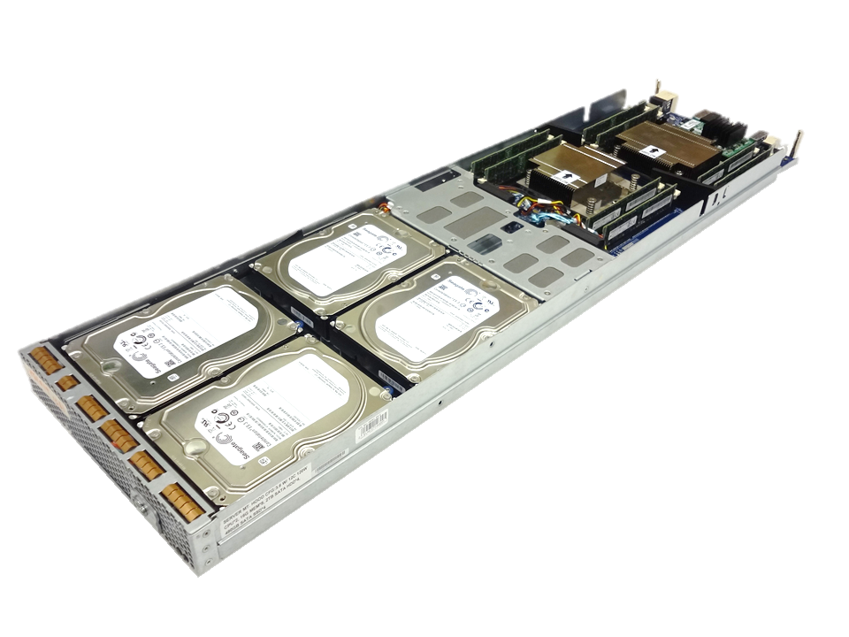
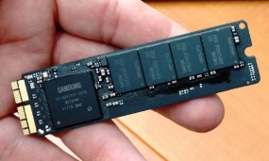
Open CloudServer V2 Design
X16 PCIe for
accelerators
28 CPU cores for high performance – Intel Xeon E5-2600 v3
Advanced networking – 40Gbe with ROCE v2
8TB of M.2 PCIe SSDs - low cost, high bandwidth commodity flash
512GB DRAM for data intensive workloads
Accelerator card expansion – GPU, FPGA
High efficiency 1600W PSU optimized for hyper-scale datacenters
40GbE NIC
with ROCE v2
Dual-socket 120W
14c CPUs
M.2 Flash solid-state storage
Notes:
The heart of the Open CloudServer V2 upgrade is a new compute blade. This blade supports the latest Intel processor enabling 28 cores per blade. More cores enables more virtual machines leading to a need to rebalance the system.
We’ve added capacity increases in all of the other subsystems on the blade. This blade supports the transition from 10G networking to 40G networking. We utilize RDMA over Converged Ethernet, ROCE v2, to improve network efficiencies moving data to and from storage.
We’ve increased the SSD flash capacity by 4X by transitioning away from SATA-based SSD flash storage to the PCI-Express based M.2 form factor. The M.2 flash cards are used in most laptops and tablets today and are transitioning to the high performance NVMe interface. The M.2’s small “stick” form factors allows for thermal efficiency improvements and lower overall power consumption of fans.
To improve the efficiencies of the processors, we’ve enabled an expansion card that can be used for things such as GPU and FPGA accelerator cards. In the chassis we’ve increased the capacity of the power supplies and optimized them for cloud datacenter designs.
Emphasize - The overall result is that a full 52U rack with 96 servers can support 2688 cores, 48TB memory, 2.3 PB disk storage, 3/4ths PB flash storage, and 3.8 Tbps network bandwidth. Microsoft has 10’s of 1,000’s of these!!!

Slide 6
IaaS Virtual Machines – Tier, Series, Size
Tiers – Define a set of capabilities that all VM sizes within the tier provide
Series – Define a set of capabilities based on the underlying host hardware the virtual machines run on
Size – Define a combination of CPU, RAM, and Disk
Example size: A2 - 2 CPU, 3.50 GB RAM, 135.00 GB Disk
Notes:
Quick vocabulary check. We will be using these terms as we discuss VMS on iaaS.
Standard Tier - Most flexibility
Supports all virtual machine configurations and features
Basic Tier – Good for development workloads, test servers, and other applications that don't require load balancing, auto-scaling, or memory-intensive virtual machines
A Series – The first series of Azure IaaS virtual machines
D Series – Solid state drives (SSDs) and faster processors
also available for web or worker roles
This series is ideal for applications that demand faster CPUs, better local disk performance, or higher memories.

Slide 7
Azure functionality for VM solutions
Notes:
Let start by looking at some of the key Azure capabilities for VM solutions

Slide 8
Key Azure functionality for VM solutions
Availability sets
VM Extensions
VM Scale Sets
Notes:
Azure has a number of functions that are crucial for VM Solutions. Note that by solutions I mean multiple different type of VMs that together create the solution.
We already touched upon these in the Compute session but I want to come back to some of these as it is important that you know these.
The components that we will cover are Availability Sets, VM Extensions and VM Scale Sets

Slide 9
Availability Sets
Configure multiple virtual machines in an Availability Set for redundancy
Configure each application tier into separate Availability Sets
Combine the Load Balancer with Availability Sets
Availability Zones (future direction)
Covered in the Compute session
Notes:
Understanding and using Availability sets is the first step in creating redundant VM Solutions, By having Availability Sets you will protect yourself for outages due to planned Azure maintenance. To provide redundancy to your solution, we recommend that you group two or more virtual machines in an Availability Set. This configuration ensures that during either a planned or unplanned maintenance event, at least one virtual machine will be available
For multi tiered solutions you should configure each tier in a separate availability set. By configuring at least two virtual machines in an Availability Set for each tier, you guarantee that at least one virtual machine in each tier will be available during maintenance events
Combine the Azure Load Balancer with an Availability Set to get the most application resiliency. The Azure Load Balancer distributes traffic between multiple virtual machines. For our Standard tier virtual machines, the Azure Load Balancer is included. Note that not all virtual machine tiers include the Azure Load Balancer
In the future Azure will start offering Availability Zones which will allow you to extend the Availability Set across two data centres (provided that the latency between them is below 2 msec)

Slide 10

Availability Sets
Availability set
SLA High Availability
Hardware and Software
Windows and Linux
Virtual Machine
Virtual Machine
SQL Server
Primary
SQL Server
Secondary
SLA 99.95

Slide 11
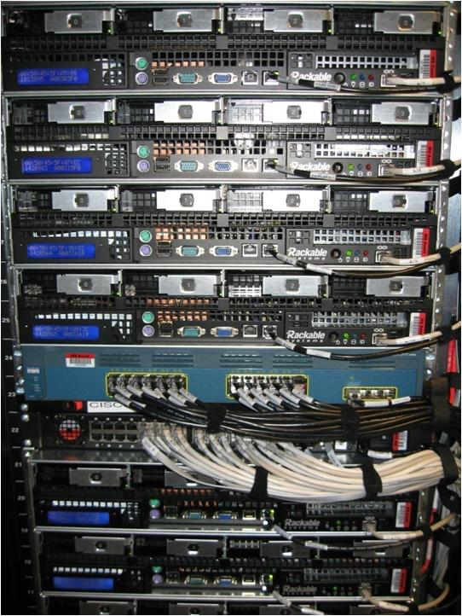
Availability Sets
Physical Machines
Power Unit
Rack Switch

Slide 12

Availability Sets
Physical Machines
Power Unit
Rack Switch
VM1
VM2
VM2
VM1
VM2
Availability Set

Slide 13
VM Extensions
These are designed to simplify VM Management
They allow for automated operation of the Virtual Machines
Pre-installed when using the MarketPlace templates
A growing number of 3rd party extensions are available
Need to be maintained
Notes:
Azure VM Extensions implement behaviors or features that either help other programs work on Azure VMs, using VM Extensions can simplify VM management as they can be used to perform tasks on the VMs without having to logging into the machines and performing the maintenance tasks
Some of the MarketPlace templates include VM Extensions, but if you are using your own images or images without the extensions you can install them manually.
There is a growing number of 3rd party extensions available on the marketplace, these include extensions for Deployment and Configuration Management, Security and Protection to mention a few.
Please note that these extensions need to be maintained and updated when there are newer versions available.

Slide 14
Using a VM Extension
Notes:
1_VMExtension Demo.docx

Slide 15
VM Scale Sets
Allows for deployment and management of a collection of VMs as a set
Provide a highly scalable and customizable compute layer for hyper scale applications
Provides for easy auto-scale
Identical VMs
Ideally stateless
Notes:
VM Scale Sets are an Azure Compute resource you can use to deploy and manage a collection of virtual machines as a set.
Scale sets are designed for building large-scale services for big compute, big data, and containerized workload scenarios.
Scale set VMs are configured identically and this enables them to scale out and in rapidly and automatically. Integrating with Azure Insights Autoscale, you get true auto scale with no need to pre-provision VMs

Slide 16
Active Directory in Azure
Notes:
Let dive into the first workload, AD on Azure

Slide 17
Why AD in the Azure?
Migration of existing “classic” workloads
Applications not born in the cloud
Application transitions and standalone applications
Disaster recovery
Dev, test, patching, app compatibility testing
Hybrid
Notes:
Many of the Microsoft Servers (like Exchange and SharePoint) require an Active Directory. If you want to move them to Azure you will need to provide AD Services to the servers running in Azure. This can be done by deploying AD Domain controllers to Azure
You can also use AD in Azure for disaster recovery scenarios, this will be covered in more detail in the Hybrid session
Some other common workloads that require AD are hybrid or dev and test.

Slide 18
How Do Customers Run AD On Azure Today?
Deploy a site-to-site VPN connections between workloads
In Azure Infrastructure Services
On-Premises
Setup replica domain controllers using Azure virtual machines
Deploy a stand-alone domain controllers in Azure
Notes:
There are 3 main mays our customers are using AD in Azure today.
In the first scenario you setup a site to site VPN connection to provide AD services to Servers running in Azure. Even though this scenario does not require the deployment of a Domain controller in Azure it is a best practice to host Domain Controllers close to the Servers to improve authentication
The second scenario is actually the same as the first one but in this case the customer does deploy Domain controllers to Azure
The third option is for cases where you have standalone environments in Azure with no connectivity to On-Premises

Slide 19
Other considerations
DNS
DCs need static IPs but VMs use DHCP
SYSVOL
Public IP addresses
Replication traffic
DIT size
Notes:
When a new DC is added, DNS will be configured upon DCPromo. You can assign a static IP/reservation once the VM is provisioned
The normal C drive is set to read/write cache. You need a separate disk before you run DCPromo, attach a disk with no caching or read/only. DO NOT USE C Or D drive. You will see an example of that in a later demo.
We will discuss IPs and SYSVOL in a later section. Also, VMS have public IPs by default. We will talk about ways to isolate DCs from the public internet later.
In a hybrid scenario - for replication, configure the AD Sites and services to ensure that you are not incurring additional network traffic due to bad routes
Consider memory intensive machines for large ADs as AD is a memory intensive
Azure Application Access

Slide 20
“NEW” AD in Azure in 10 steps
Plan network (IPs, VNets, DNS)
Create availably set/resource group
Create storage account
Create network
Create Machine 1 with extra data disk for SYSVOL (no caching)
Promote to DC
Create Machine 2 like machine 1 in availability set
Join domain
[Recommended] Secure communication endpoints
[Optional] Create jump server for RDP access
Notes:
Deploy a Windows Azure Virtual Network
By default, VMS Use DHCP-leased addresses on your virtual DCs. this is NOT an option
Install and configure Windows Server DNS on the domain controller(s) in Windows Azure
Configure both the DCs’ and the domain-members’ DNS client resolver settings as follows:
Preferred DNS server: on-premises DNS IP address if using Hybrid
Alternate DNS server: loopback address or another DNS server running on a DC on the same virtual network
Always create at least 2

Slide 21
Service Healing and AD
What is service healing?
A process in which Windows Azure automatically restores VMs to a running state after it detects that a given service has failed
Service-healing is one of the aspects of Windows Azure that contributes to availability and resiliency
DCs see this as an unplanned reboot
… And AD, like many distributed systems, is sensitive to being rolled back in time
Notes:
Service Healing: “In the unlikely event of a change in cabin-pressure, oxygen masks will automatically drop from the ceiling above you…”
joking aside, let’s briefly discuss the unplanned events
as unlikely and unplanned as they most certainly are, we still need to understand what happens
What effect does service-healing have on domain controllers?
the MAC address of the domain controller WILL change
the processor/CPU ID of the VM WILL also change
the IP address of the VM will NOT change
requires that the VM is deployed on a Windows Azure virtual network
writes to Active Directory’s DIT/logs/sysvol will NOT be lost
requires that the Windows Azure disk-type holding them does not provide write-behind caching (use “data-disks”, not “OS-disks”)
Do the preceding behaviors affect Active Directory?
no, domain controllers take NO dependency on MAC address or processor/CPU ID
again, ensure you deploy the Active Directory DCs on a Windows Azure virtual network
ensure that writes to Active Directory’s databases are durable
use Windows Azure “data-disks”

Slide 22
Potential Issues When AD is Virtualized
New feature called “VM Generation ID” in Windows Server 2012
AD invokes safeguards when VM Generation ID changes
RID pool is discarded
Bottom Line
DO NOT START/STOP from the portal, use the client
Avoid shutting down all DCs at the same time
Do not pause or save state
Do not clone or copy below Windows Server 2012
Notes:
You should shut down and restart a VM that runs the domain controller role in Azure within the guest operating system instead of using the Shut Down option in the Azure Management Portal. Today, using the Management Portal to shut down a VM causes the VM to be deallocated. A deallocated VM has the advantage of not incurring charges, but it also resets the VM-GenerationID, which is undesirable for a DC. When the VM-GenerationID is reset, the invocationID of the AD DS database is also reset, the RID pool is discarded, and SYSVOL is marked as non-authoritative.
You can use POSH to view this ID:
Import-module activedirectory ; (Get-ADObject “CN=MACHINENAME,OU=Domain Controllers,DC=FQDN,DC=TLD” -server DCNAME -property msds-generationid).’msds-generationid’
Each time the domain controller is rebooted AD DS also compares the current value of the VM GenerationID from the virtual machine against the value in the DIT and, if different, it resets the invocationID, discards the RID pool and updates the DIT with the new value. (FROM http://social.technet.microsoft.com/wiki/contents/articles/12149.windows-server-2012-virtualization-safeguards.aspx)
The feature known as VM-Generation ID allows hypervisor vendors to expose a virtual machine identifier that Windows Server 2012 domain controllers can use to detect the state of a virtual machine and trigger new Active Directory safeguards. These safeguards protect the Active Directory from the dreaded USN roll-back if a virtual machine is reverted to a snapshot or rolled back by other mechanisms.

Slide 23





How Domain Controllers are Impacted
Timeline of events
DC1
DC2
TIME: T1
Create
Snapshot
USN: 100
ID: A
RID Pool: 500 - 1000
USN rollback NOT detected: only 50 users converge across the two DCs
All others are either on one or the other DC
100 security principals (users in this example) with RIDs 500-599 have conflicting SIDs
+100 users added
TIME: T2
USN: 200
ID: A
RID Pool: 600- 1000
DC2 receives updates: USNs >100
DC1(A) @USN = 200
TIME: T3
T1 Snapshot
Applied!
USN: 100
ID: A
RID Pool: 500 - 1000
+150 more users created
TIME: T4
USN: 250
DC1(A) @USN = 250
ID: A
RID Pool: 650 - 1000
DC2 receives updates: USNs >200
Notes:
USN and InvocationID
AD DS, depends upon two logical increasing values :
a) USN (Update Sequence Number) that is assigned to transactions on each domain controller
b) InvocationID that is the Active Directory database GUID, used to identify the database instance (version of the database).
Note : InvocationID is stored in an attribute on the NTDS Settings object
The relative identifier (RID) master. The RID master allocates RIDs to all domain controllers to ensure that all security principals have a unique identifier.
You can create a new security principal object (user, group, or computer) on any domain controller. When you create a security principal object, the domain controller attaches a unique Security ID (SID) to the object. There are four elements of a domain SID, one of which is the RID for the domain.
The following table describes the elements of the domain SID: S-1-5-Y1-Y2-Y3-Y4.
Elements of a Security Identifier (SID)
S-1 - Indicates a revision 1 SID. At this time 1 is the only SID revision in use.
5 - Indicates the issuing agency or issuing authority. A 5 always indicates Windows NT or AD DS domains. Note that a well-known SID may use a 1 or 0 as the issuing identity to signify that it is a well known SID.
Y1-Y2-Y3 - The domain identifier portion of the SID. This is the same for every security principal object created in that domain.
Y4 - The relative ID (RID) for the domain, which represents a user name or group. This is obtained from the RID pool on a domain controller at the time the object is created.
The RID master does not actually maintain a pool of numbers. Rather, it maintains the highest value of the last range it allocated. When a new request is received, it increments that value by one to establish the low value in the new RID pool and then adds four hundred and ninety nine to establish the new maximum value. It sends these two values to the requesting domain controller to use as its next allocation of RIDs.
((http://blogs.technet.com/b/askds/archive/2011/09/12/managing-rid-pool-depletion.aspx))

Slide 24
Azure + ADFS + Office 365
Fully supported scenario
Make sure you have at least 2 DCs accessible to ADFS servers
Careful if federating your Azure subscription
If ADFS goes down, cannot log in to fix it
Always keep at least one un-federated account
Follow best practices: http://msdn.microsoft.com/library/azure/jj156090.aspx#BKMK_WhyADFS
Notes:
Another common workload is ADFS for Office 365 deployments. You can deploy additional DCs in the Azure, and configure ADFS for SSO federation.
Be careful when you configure this. You should follow the best practices for ADFS and Office 365

Slide 25
AD on IaaS Tips
If you know you will need to shut it down, use 1 DC
For production, use 3 DCs in the same availability set
Distributed across update and fault domains
Potential for all DCs to restore from an unknown state
3 provides for at least 1 authoritive SYSVOL
Choosing a DC, GC or RODC?
Cloud only – yes
Hybrid – maybe
RODC – primarily used for insecure environments
Notes:
Some tips when looking at AD in Azure workloads
If there is a possibility that you will need to turn off the DC for cost (example dev and test), the only deploy 1 DC. Multiple DCs that are deallocated may cause orphaned objects when they are brought back online (who is authoritve??)
For prod workloads, make sure you deploy at least 3. This allows you patch and still be highly available
When making a choice between the standard DC roles, look at the possible workload. If it is cloud only workload, then yes. For hybrid. You will have to look at the connectivity options and the reasons you are using Azure.
RODC are primarily used for branch scenarios, when there is a possibility that your physical DC will walk away. Not recommended for Azure.

Slide 26
Isolate AD Machines For Security
Three basic options for machine isolation:
Between machines deployed to a single virtual network - Windows Firewall
Between machines deployed to distinct virtual networks - distinct cloud services
Between machines to distinct virtual networks
VPN connection from on-premises
Notes:
When you deploy your AD workload, use a separate resource group and network group to isolate it from other machines. This helps to protect the servers from attack. There are various options for isolation.
In order to secure the server, Windows Firewall could be configured to block all inbound connections, and inbound rules would be setup to determine:
1) what local ports will accept connections,
2) what remote ports from which connections will be accepted,
3) what remote IP addresses will be accepted,
4) what authorized users can make connections, and
5) what authorized computers can make connections

Slide 27
SQL in Azure

Slide 28
Why SQL in Azure IaaS?
If SQL PaaS has a limitation
Other Scenarios
More fine grained control on resources
License portability
Backup
Dev and test
Legacy applications (either 1st or 3rd party)
PaaS integration scenarios
Notes:
Why would you choose to run SQL in Azure IaaS instead of using the PaaS offering?
As the PaaS offering of SQL is today more limited than a SQL installation you might have requirements that make the PaaS offering not be viable.
In a IaaS solution you also have more fine grained control on all resources in SQL Server.
There might also be cases where you want to reuse your OnPremises SQL Server licenses

Slide 29
SQL Server VS. Azure SQL
Area | SQL IaaS | SQL PAAS
Features | Full compatibility with SQL Server box product editions | Not all features
Cost | Requires licensing | Included in service
Development | Use existing | New
SLA | None | When deployed in an availability set. 99.95
Storage and Perf | Backed by Azure Storage
Database scale | Limited by resources | 500 GB
Authentication and security | Based on AD or SQL | Based on Azure AD or App
Notes:
https://azure.microsoft.com/en-us/documentation/articles/data-management-azure-sql-database-and-sql-server-iaas/
Supported versions
SQL Server 2012, 2008 R2, 2008
Supported features
All SQL Server features supported except failover clustering
SQL Server provisioning
Cloud-first using stock images, bring your own server and VHD, capture cloud images
SQL Server licensing
Pay by the hour or migrate your own license through Software Assurance*

Slide 30
Migrating Database Server Options
Bring your own image
Use the Gallery image
Upload VHD to Microsoft Azure storage account
instantiate virtual machine
SQL Server 2008 and up
License mobility with software assurance
Latest SQL Version (2014)
Default options
Includes SQL Server Integration Services, Reporting Services, and Analysis Services
Images refreshed monthly
Once deployed, you patch
Notes:
When planning a move of SQL Server you essentially have 2 options. You can either create your own SQL VM or create one based on the SQL Image from the Gallery
Once you have a SQL environment configures in Azure you can move the data using various options. You can backup the data from your On-Premises SQL environment to Azure and then restore it to the SQL instance running on Azure.
You could also use the File storage in Azure and save the SQL backups there and then restore it to Azure

Slide 31

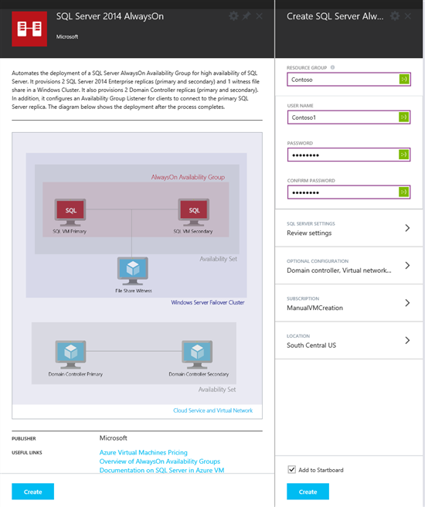
Microsoft Azure SQL Server Templates
Templates to create a complete environment out of the box are available
Automates the creation of a SQL Server AlwaysOn Availability Group
Taking care of the setup steps behind the scenes
31
Notes:
Use Azure Templates to provision and deploy Azure resources in seconds
An Azure Template is a description of an Azure application's resources
Notifications show details that occur when you use an Azure Template
The Website + SQL Azure Template
Azure Templates are described using JSON

Slide 32
Configuring SQL Server Virtual Machines
Notes:
https://azure.microsoft.com/en-us/blog/new-configuration-experience-sql-server-virtual-machines/

Slide 33
SQL Server (or other I/O hogs)
IaaS blob storage 0-500 IOPS, 4-5 msec latency
Can be anything in that range
No performance SLA, just an availability SLA
Consider leveraging multiple data disks
Follow guidelines in the Azure SQL Server Whitepaper
http://msdn.microsoft.com/en-us/library/windowsazure/dn248436.aspx
Remember your on-premises troubleshooting
Notes:
Standard Disks in Azure are throttled to 500 iops !!
Given OS Activity, you’ll end up with ~150 iops on the C:\ drive
Storage Account is throttled at 20.000 requests per second / 60 MB per second (theory)
20.000 / 500 = 40 – so try to not put more than 40 VHDs in a single Storage Account
First solution = add Data Disks, and stripe them as Simple Storage Spaces
8 disks = 8 x 500 iops = 4000 iops
Allocation Unit Size = Space Interleave = 64kb
Number of Columns = number of Data Disks

Slide 34
What about tempDB on the D:\?
NO unless you are using D or G Series
Better perf over multiple disks
If VM goes down, TempDB has to get recreated
Notes:
http://blogs.msdn.com/b/cindygross/archive/2009/11/20/compilation-of-sql-server-tempdb-io-best-practices.aspx
People are tempted to use D: as a scratch location because it has higher I/O speeds
Not persisted to blob storage = faster
OK as long as really is scratch
Be careful using D: for SQL tempdb
Need to ensure folder structure is recreated on VM startup, so just don’t do it
Still thinking through the new SSD temp drives
Don’t put anything on D: you care about
Don’t put anything C: if you care about OS performance
For D and G Series only – see below for TempDB guidance
http://blogs.technet.com/b/dataplatforminsider/archive/2014/09/25/using-ssds-in-azure-vms-to-store-sql-server-tempdb-and-buffer-pool-extensions.aspx

Slide 35
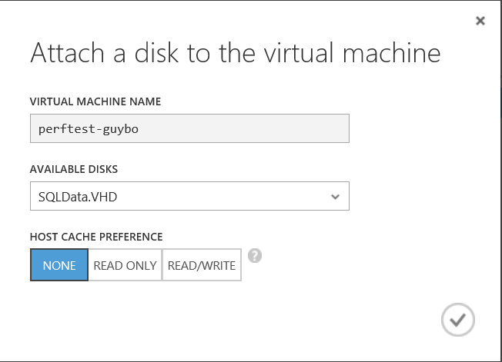
Disk Caching Best Practices for SQL Server
OS Disk
“Read Write” (default) reduces read latency for IO intensive workloads with smaller DBs (<=10GB)
Working set can fit in disk cache or memory, reducing blob storage IO
Data disks
Cache setting depends on the IO pattern and workload intensity
Use default of “None” (disable) for higher rate of random IOs (e.g. OLTP) & higher throughput
Bypasses physical host local disks, maximizing IO rate
Consider enabling read cache for latency sensitive read heavy workloads
Notes:
I/O sub-system
Storage optimization for SQL Server transactional and analytical workloads is a very important task that requires careful planning and analysis. There is already a tremendous amount of information that explains how to deal with I/O subsystems with different performance characteristics in a traditional on-premises environment, such as spindles, host bus adapters (HBAs), disk controllers, and so on. For more information, see Analyzing I/O Characteristics and Sizing Storage Systems for SQL Server Database Applications.
Azure disks are implemented as a service, so they do not offer the same range of complex configuration options available in traditional on-premises I/O subsystems. This has both benefits and costs. For instance, Azure disks offer built-in local redundancy and optional geo-redundancy for disaster recovery through the use of replicas. To achieve the same level of redundancy in on-premises deployments, you would need to set up multiple disk arrays in multiple locations and a synchronization mechanism, such as, a storage area network (SAN) replication. On the other hand, the Azure disk performance is not as predictable as on-premises disk I/O subsystem due to several factors:
Azure Infrastructure Services is a shared, multi-tenant service. Resources like host machines, storage services and network bandwidth are shared among multiple subscribers.
Performance may vary depending upon where and when you provision your virtual machines due to a variety of factors including differences in hardware. Your virtual machine may get moved to a different host due to a hardware replacement necessitated by a failure or lifecycle refresh.
The performance and availability of your virtual machines may be impacted (positively or negatively) by maintenance operations such as platform upgrades or performance and reliability fixes.
When you use cloud-based storage options in Azure, you sacrifice granular control and deep performance optimization options for lower costs, simplicity and out-of-the-box redundancy.
Azure disks are connected to virtual machines via a network infrastructure and that can introduce higher network latency compared to the local attached disks in on-premises environment.
For a detailed discussion on different storage configurations, see the Best practices and recommendations for optimizing SQL Server performance in Azure VMs section.

Slide 36
Best Practices for SQL Server on Azure VMs
Storage Recommendations
Do not use write caching
Avoid using operating system drive for large databases
Consider putting database and transaction log files on separate drives
Notes:
SQL Always On Availability Groups
Use V2 machines to utilize 3 fault domains instead of 2
Cannot use more than 1 virtual NIC – internal load balancer doesn’t support multiple

Slide 37
SQL Server IaaS VM Extension
Allows for configuration of automated backups and patching
Installed by default when using the Template from the MarketPlace using the new portal
Must be installed manually for all other deployment options
Notes:
This extension enables SQL Server in Azure Virtual Machines to use SQL automated backup and SQL automated patching:
It automates the scheduling of backups for all databases for the default instance of SQL Server in the VM
The SQL automated patching lets you configure a maintenance window during which updates to your VM can take place, so you can avoid updates during peak times for your workload.
If you provision your SQL Server VM using the Azure portal, the extension will be automatically installed. For SQL Server VMs provisioned with the Azure classic portal, or for VMs which you bring your own SQL license to, you can add this extension to an existing VM using the following Azure PowerShell cmdlet.
Set-AzureVMSqlServerExtension

Slide 38
Migrating workloads

Slide 39
Workload Migration Process
Analyze
Prepare
Migrate
Solution
Infrastructure
Configuration
Deploy base infrastructure
Deploy Solution
Deploy solution infrastructure
Migrate data
Configure the solution
…
Notes:
If you look at a migration process for moving solutions to Azure you can separate it in 3 steps: Analyze, Prepare and Migrate
The goal of the Analyze phase is to get a clear understanding of the solution that you have deployed On-Premises. Without knowing the components and their dependencies it is difficult to plan the setup for your solution when hosted on Azure.
Once you know what your solution will look like in Azure you can start deploying the infrastructure components to Azure.
The final step is to deploy the actual solution and it’s supporting data and configuration

Slide 40
Understanding the Solution
Analyze
Analyze/understand the application
Components
Tiers
LoB integration points
Analyze the solution configuration
Connection strings
web.config entries
Notes:
The goal for the analysis phase is to identify all the components, configurations and dependencies of the solution.
The analysis depend very much on the type of solution. For instance a SAP solutions has different characteristics than a SharePoint solution
If we look at an SharePoint solution the things we should document include:
Nr of web applications
Which Service Applications are deployed
What custom solutions are deployed
What authentication models are used
Document any LoB integration points
Etc
For SAP the list would be different

Slide 41
Preparing the base infrastructure
Prepare
Planning the base infrastructure
Install the base infrastructure
AD, SQL, Storage, networking, firewalls, etc.
Install the solution infrastructure
Solution components
Additional Services
Notes:
In this phase you will plan and prepare the Azure Infrastructure for your solution. You would deploy the components the solution requires. These typically include AD, SQL, networking.
In case your solution requires additional servers you would deploy them as well.
If we again look at the SharePoint example then we would deploy the SharePoint binaries to all the servers but we would not configure it yet.
After this phase Azure would be ready for the deployment of your solution.

Slide 42
Migrate
Migrate
Deploy the solution
Solution artifacts
Migrate the solution data
Databases
Other supporting data
Configure the solution
Notes:
This step entails the deployment and configuration of the solution. This might include installing software artifacts, restoring SQL databases etc.
After this phase your solution is ready for the users.
Again for SharePoint this would include configuring the farm, restoring the SharePoint SQL content databases from the On-Premises environment, deploying the web applications, the solutions and the service applications

Slide 43
Designing Complex Solutions in the Cloud

Slide 44
Understand Service Limits, Quotas and Constraints
Storage and Subscription Limits
Cloud Service
Service Manager vs. ARM
Networking
Traffic Manager
DNS
Notes:
You can roughly calculate the number of highly utilized disks supported by a single storage account based on the transaction limit. For example, for a Basic Tier VM, the maximum number of highly utilized disks is about 66 (20,000/300 IOPS per disk), and for a Standard Tier VM, it is about 40 (20,000/500 IOPS per disk). However, note that the storage account can support a larger number of disks if they are not all highly utilized at the same time.
35 premium, 40 standard for number of disks

Slide 45
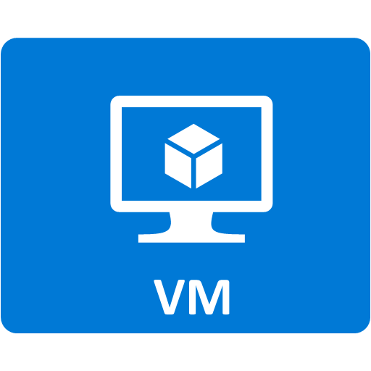
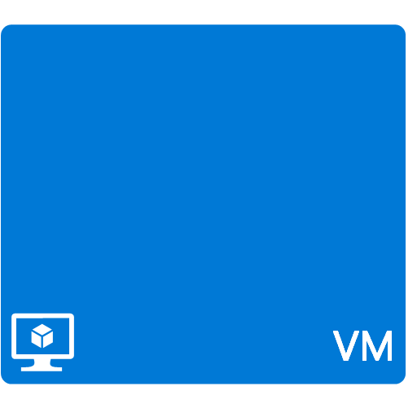
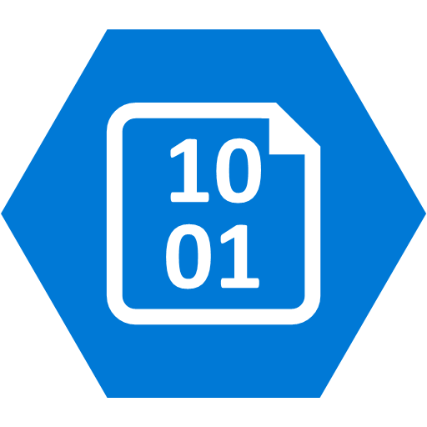
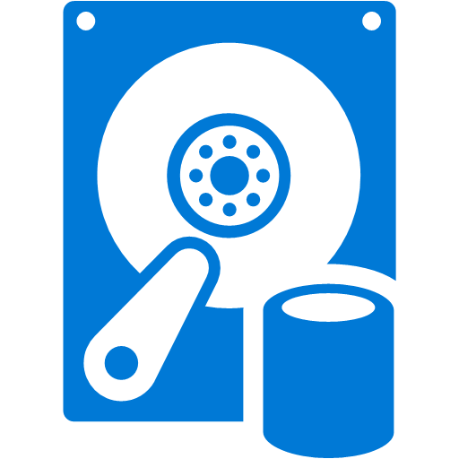


Understanding the Cost Components
Bandwidth in/out
Connectivity
Notes:
See http://www.windowsazure.com/en-us/pricing/calculator/ for up to date information
Service
Description
Cost
1. In/Out Bandwidth
This is the web traffic between the user's browser and the site.
Inbound: Free
Outbound (North America and Europe): $0.12 per GB
2. Compute
Virtual machines, for the time each one is running.
Small size virtual machine: $0.115 per hour
Medium size virtual machine: $0.23 per hour
Cloud Services roles, for the time each role is running.
Small size role: $0.12 per hour
Medium size role: $0.24 per hour
3. Azure Storage
Up to 1 TB with geo-replication: $0.125 per GB
Up to 1 TB without geo-replication: $0.09 per GB
4. Transactions
Each interaction with the storage system is billed.
$0.01 per 100,000 transactions
5. Database
SQL Server hosted in a VM
Small or medium size VM: $0.55 per hour
Azure SQL Database, cost per month.
Up to 100 MB: $4.995
Up to 1 GB: $9.99
Up to 10 GB: First GB $9.99, each additional GB $3.996
Up to 50 GB: First 10 GB $45.954, each additional GB $1.998
Up to 150 GB: First 50 GB $125.874, each additional GB $0.999
6. Connectivity
Virtual Networks and Connect
$0.05 per hour per connection

Slide 46
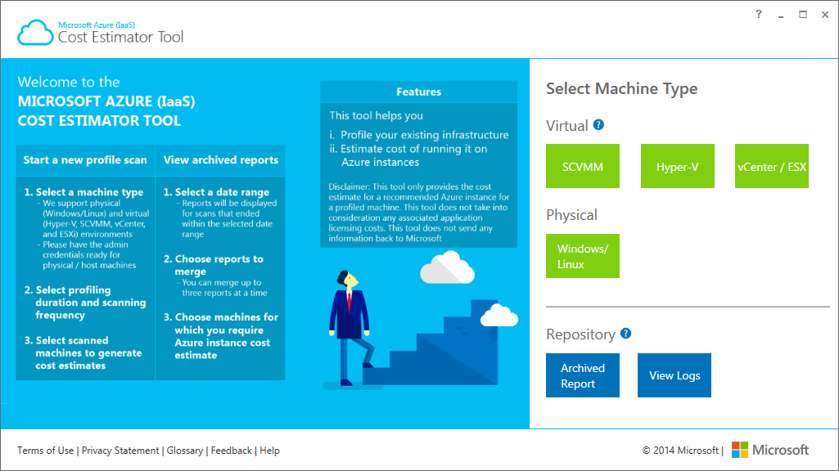
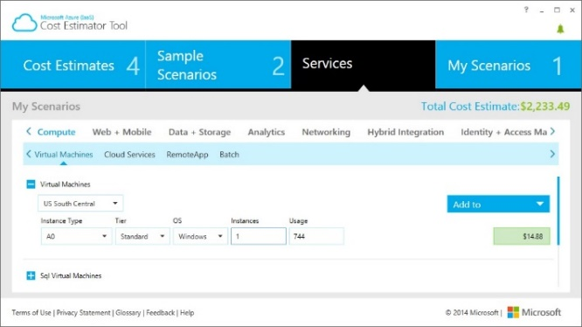
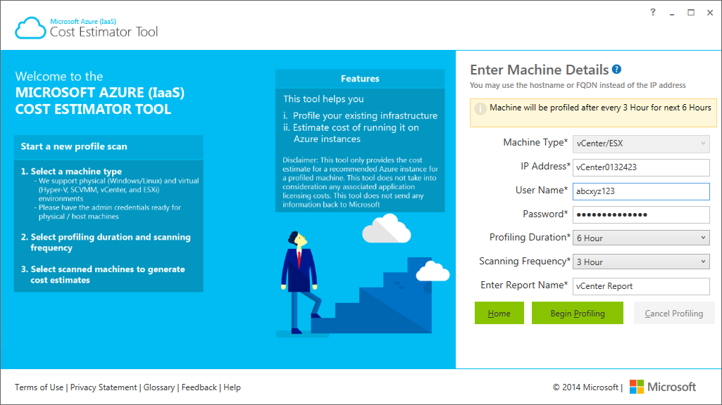
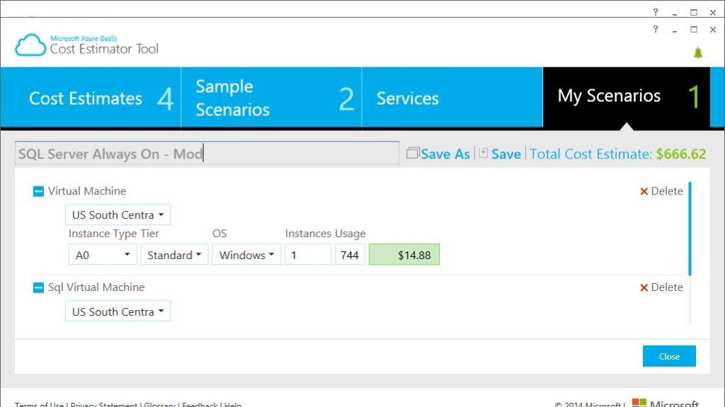
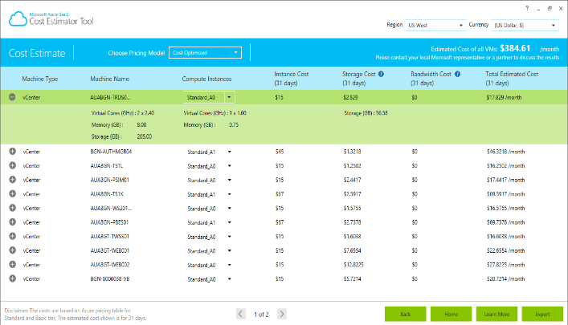
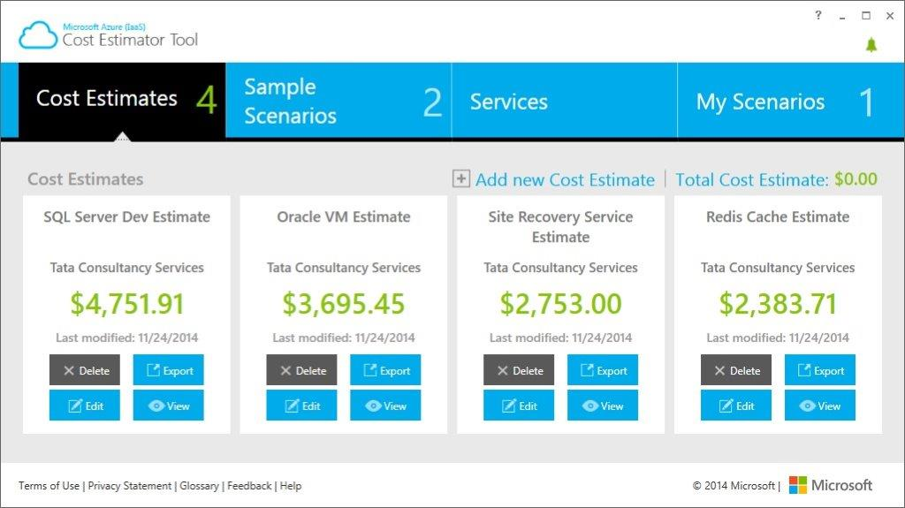
Microsoft Azure Cost Estimator Tool
Scan On Premise workload
Select Azure Services
Estimate the monthly usage
Input required usage
Map it to Azure instances
Bucket them to scenarios
Choose Currency and Region
Choose Currency and Region
Estimate the monthly cost on Azure
Create cost estimate for the customer
Scan your Environment and get the estimated cost of migrating workload to Azure
Choose your environment and Azure services and create a cost estimate (proposal)
Notes:
Publicly available for download http://aka.ms/azurecosttool

Slide 47
More Tips
Follow our patterns & practices guidance on github at github.com/mspnp (contributions welcomed!)
Cloud pattern guidance - https://github.com/mspnp/azure-guidance
Common performance related anti-patterns - https://github.com/mspnp/performance-optimization

Slide 48
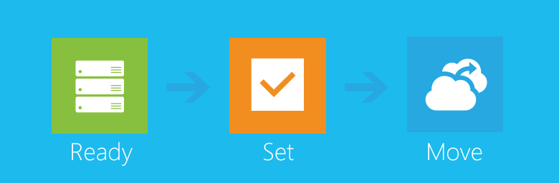
Windows Azure Virtual Machine Readiness Assessments
Download here: http://go.microsoft.com/fwlink/?LinkID=335841
Notes:
EPG: Consider using this as conversation starter for moving your customers to Windows Azure Virtual Machines.
DPE & MCS: Consider using as a scoping tool for use in Azure Virtual Machine migration POC’s or pilots.
SUPPORT: Help with customers migration planning.
PREMIER: Look for this report to be included with your customers AD, SQL & SharePoint RaaS’s in late February
ALL: Review the data sheet to understand how it can help your customers.
ALL: Download the Assessment and provide early feedback.
ALL: Look for the future Windows Azure Virtual Machine Optimization Assessment coming in Q3!
ALL: Goto the GBS lounge to find out more!

